Slide 1
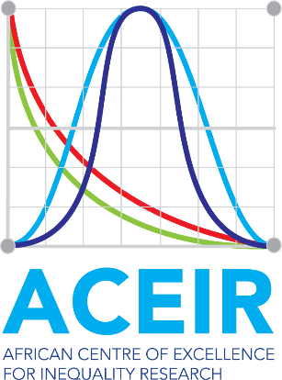

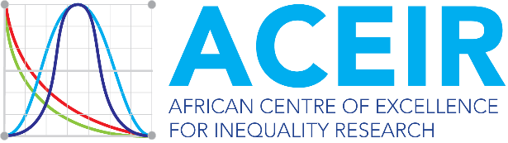


AFRICAN CENTRE OF EXCELLENCE FOR INEQUALITY RESEARCH
MULTIDIMENSIONAL POVERTY CONCEPTUALISATION: APPLICATION TO CHILD POVERTY AND OTHER MEASURES
Raymond Elikplim Kofinti (PhD)
University of Nairobi, Kenya

Slide 2
This Presentation
Multidimension poverty conceptualisation
Application to child poverty assessment
Application to other multidimensional measures in microeconomics analyses
Practical approach to the measures: hands-on

Slide 3
Multidimension poverty conceptualisation
What is multidimensional poverty
Conceptually, poverty has traditionally been understood as a lack of money with statistics on consumption or expenditure acting as a proxy for a household's quality of life
However, in recent decades a consensus has gradually built that focusing on monetary poverty alone, or on any single indicator for that matter, is not enough to capture the lived reality of poverty and that measurement can do more
Multidimensional poverty views poverty as an experience of overlapping deprivations.
A critical mass of possible deprivations is used to identify multidimensional poverty

Slide 4
Multidimension poverty conceptualisation
Rationale for Multidimensional Poverty Assessment
Observations from participatory studies reveal that people in poverty described their experience as one of multiple deprivations
To enhance our understanding of poverty to inform action
Complements monetary measures of poverty to create a more comprehensive picture of poverty
Projects also the intensity of poverty – the average share of weighted deprivations faced by poor people.
Multidimensional Poverty Index (MPIs) go beyond dashboards to shed light on different combinations of poverty being experienced simultaneously
To reveal poverty which would otherwise be hidden and address it
Internationally recognised approach

Slide 5
Alkire Foster(AF) method
The Alkire-Foster (AF) method is designed to be an intuitive counting method to measure complex topics, which was created by Alkire and Foster (2011).
#1. The AF method first considers if a person (or household, depending on the ‘unit of analysis’) is deprived or non-deprived in each indicator
#2. Each indicator has a weight, which shows its relative importance
#3. A person’s deprivation score is computed by adding up the weighted indicators in which they are deprived.

Slide 6
Alkire Foster(AF) method
#4. To identify who is poor, a poverty threshold, or cutoff, is set. Each person is categorised as poor or not poor depending on whether their deprivation score is equal to or greater than the poverty cutoff.
#5. Validation analyses paramount
#6. Robustness Tests are performed to ensure the structure of the MPI is not unduly sensitive to its parameters.

Slide 7
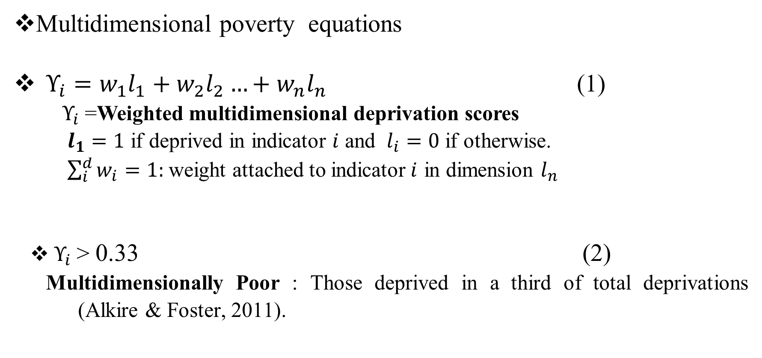
Alkire Foster(AF) method
Multidimensional poverty equations
$Υ_{i}=w_{1}l_{1}+w_{2}l_{2}…+w_{n}l_{n}$ (1)
$Υ_{i}$=Weighted multidimensional deprivation scores
$l_{1}=1$ if deprived in indicator $i$ and $l_{i}=0$ if otherwise.
$\sum_{i}^{d}{w_{i}}=1:$weight attached to indicator$i$ in dimension $l_{n}$
$Υ_{i}$> 0.33 (2)
Multidimensionally Poor : Those deprived in a third of total deprivations (Alkire & Foster, 2011).

Slide 8
The three key statistics of the MPI
Incidence (H): The proportion (expressed as a percentage) of the population who are multidimensionally poor. It is sometimes called the ‘poverty rate’ or ‘headcount ratio’
Intensity (A): The average percentage of weighted indicators in which poor people are deprived – that is, the average deprivation score among poor people.
MPI (Mo): The headline figure of poverty representing the share of possible deprivations that poor people in the society experience.
The MPI is computed by multiplying the incidence by the intensity (MPI=H x A) and the MPI ranges from 0 – 1,
The MPI is the decomposable component of the measure

Slide 9
Multidimension poverty conceptualisation
Global MPI
The global MPI is an example of an MPI that has been customised to enable comparisons across countries
OPHI publishes the global MPI annually with the United Nations Development Programme to highlight multidimensional poverty across 100 countries in developing regions
Global MPI

Slide 10
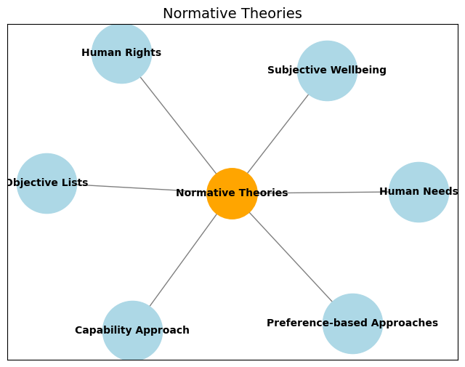
Normative Theories in Measurement Design
Alkire et al. (2015)
Notes:
The choice of space: The choice of space determines whether poverty is measured in
the space of resources, inputs and access to services, outputs, or functionings and capabilities.

Slide 11
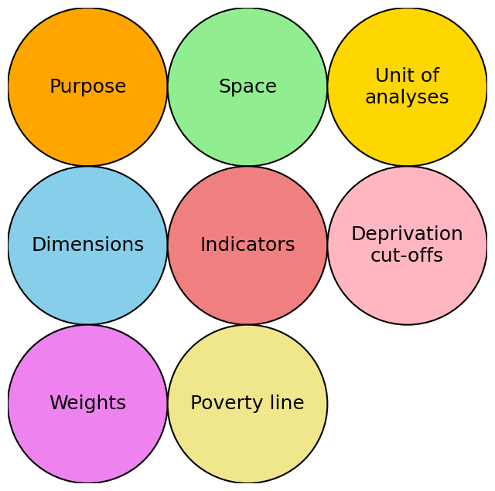
Normative Choices in Measurement Design
Alkire et al. (2015)
Notes:
The choice of space: The choice of space determines whether poverty is measured in
the space of resources, inputs and access to services, outputs, or functionings and capabilities.

Slide 12
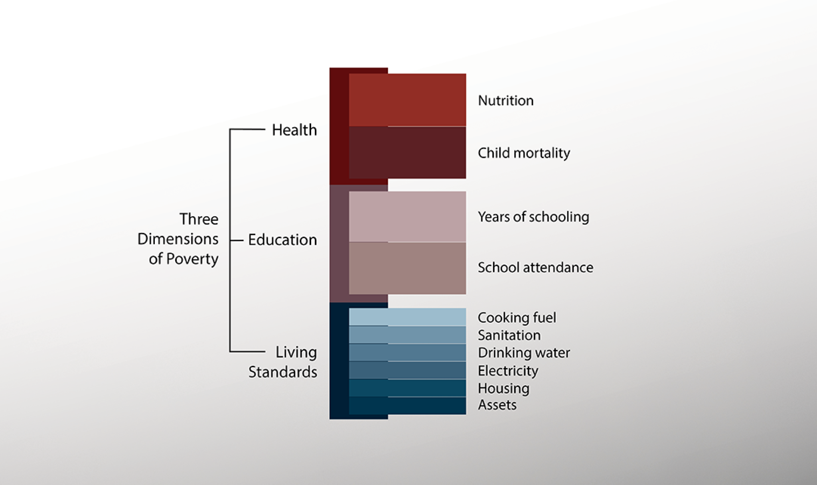
The Global MPI
Global MPI

Slide 13
Global MPI – Dimensions, Indicators, Deprivation Cutoffs, and Weights
Dimensions | Indicator | Deprived if…. | SDG area | Wgt
 | Nutrition | Any person under 70 years of age for whom there is nutritional information is undernourished. | 2 | 1/6
Health (1/3) | Child mortality | A child under 18 has died in the household in the five-year period preceding the survey | 3 | 1/6

Slide 14
Global MPI – Dimensions, Indicators, Deprivation Cutoffs, and Weights
Dimensions | Indicator | Deprived if…. | SDG area | Wgt
 | Years of schooling | No eligible household member has completed six years of schooling. | 4 | 1/6
Education (1/3) | School attendance | Any school-aged child is not attending school up to the age at which he/she would complete class 8 | 4 | 1/6

Slide 15
Global MPI – Dimensions, Indicators, Deprivation Cutoffs, and Weights
Dimensions | Indicator | Deprived if…. | SDG Area | Wght
 | Cooking fuel | A household cooks using solid fuel, such as dung, agricultural crop, shrubs, wood, charcoal, or coal. | 7 | 1/18
Living Standards (1/3) | Sanitation | The household has unimproved or no sanitation facility or it is improved but shared with other households. | 6 | 1/18
 | Drinking water | The household’s source of drinking water is not safe or safe drinking water is a 30-minute or longer walk from home, roundtrip.7 | 7 | 1/18

Slide 16



Global MPI – Dimensions, Indicators, Deprivation Cutoffs, and Weights
Dimensions | Indicator | Deprived if…. | SDG Area | Wght
 | Electricity | The household has no electricity. | 7 | 1/18
Living Standards | Housing | The household has inadequate housing materials in any of the three components: floor, roof, or walls. | 11 | 1/18
 | Assets | The household does not own more than one of these assets: radio, TV, telephone, computer, animal cart, bicycle, motorbike, or refrigerator, and does not own a car or truck. | 1 | 1/18

Slide 17
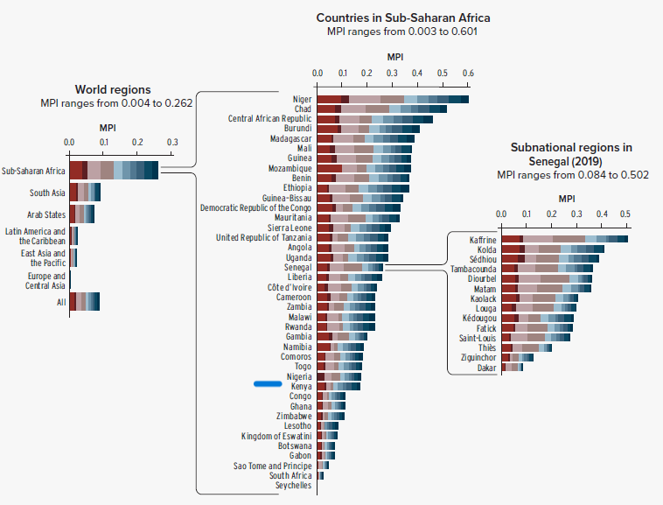
The Global MPI-2023
Global MPI

Slide 18
Application to child poverty
What is childhood Poverty?
Childhood poverty is widely understood as “deprivation of the material, spiritual, and emotional resources needed for children to survive, develop and thrive” (UNICEF, 2004)
The definition entails a multidimensional perspective to poverty
Why should we focus on multidimensional child poverty?
Poverty reduction must begin with children ( UNICEF,2004)
Holds the key to breaking the cycle of poverty
Younger family members are most innocent and vulnerable victims of household poverty

Slide 19
Application to child poverty
Child Poverty is a denial of human rights
Both ‘income’ and ‘basic needs’ poverty can make valid contributions to the objective of poverty reduction.
Children experience poverty differently from adults; they have specific and different needs.
Transient vs permanent

Slide 20
Application to child poverty
Normative considerations
Step 1 – Dimensions of Child Poverty
National norms, standards, or legislation
Internationally-agreed definitions, international conventions (UN, Human rights perspective etc)
Regionally-agreed definitions
Theories written by scholars, researchers, academia (e.g. Sen, 1999; Townsend, 1979; Gordon, 2003);

Slide 21
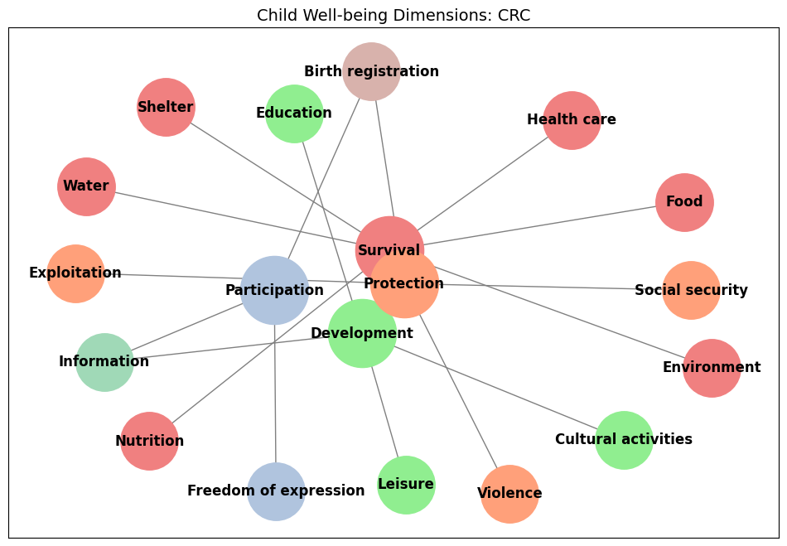
Application to child poverty
De Neubourg et al. (2013); UN, 1989

Slide 22
Application to child poverty
Step 2 - Select the dataset(s) and choose the unit of analysis
Step 3 - For each dimension, select indicator(s) and define the reference population
Step 4 - Specify indicator threshold(s) and construct the indicator(s)
Step 5 - Decide upon the life-cycle stages and choose age group(s) for the multidimensional deprivation analysis
Step 6 - Decide how to weight indicators and how to aggregate them into dimensions
Step 7 - Decide upon the identification method of the multidimensionally deprived children

Slide 23
Application to child poverty
Table 2: Dimensions, Indicators, Weights and Age Cohorts (Empirical Work)
Dimensions (Weight) | Indicators | Age Cohorts
Survival (1/3) | Food (1/18), Nutrition (1/18), Water (1/18), Housing (1/18), Sanitation (1/18) and Vaccination (1/18) | 0-5 & 6-17 yrs
Development (1/3) | School attendance (1/12), Quality of childcare (1/12), Electricity (1/12) and Educational Assets (1/12) | 0-5 & 6-17 yrs
Safety (1/3) | Exposure to violence (1/9), Health insurance (1/9) and Exposure to child labour (1/9) | 0-5 & 6-17 yrs

Slide 24
Application to child poverty
Table 3: Kenya’s Child Poverty-2017: KNBS & UNICEF
Dimension | Indicator
Development | Stunting
Health | Vaccinations, Birth attendance, Health-related knowledge (ORS)
Nutrition | Underweight or Wasting, Vitamin A supplement in last 6 months
Education | School attendance, School lag, Illiteracy
Health-related knowledge | Knowledge about HIV/AIDS, Knowledge about diarrhoea treatment:
Access to Information | Information devices, exposure to mass media
Water | Safe drinking water
Sanitation | Improved toilet facility
Housing | Dwelling material (floor, wall & roof), indoor air pollution

Slide 25
Application to child poverty
Some empirical works on child poverty
Kofinti, R. E., Koomson, I., & Peprah, J. A. (2024). Borrower discouragement and multidimensional child deprivation in Ghana. The Journal of Economic Inequality, 22(1), 49-67.
2. Koomson, I., Kofinti, R. E., & Laryea, E. (2024). Financial inclusion and multidimensional child poverty. Review of Economics of the Household, 22(1), 237-260.
3. Kofinti, R. E., & Annim, S. K. (2016). Child deprivation and income poverty in Ghana. In: Arndt, C., Tarp, F. (eds) Measuring Poverty and Well-being in Developing Countries (pp.178-193). Oxford University Press.
4. Consumption Inequality and Multidimensional Child Poverty in Ghana: Does Access to Communal Services Matter? (forthcoming)

Slide 26
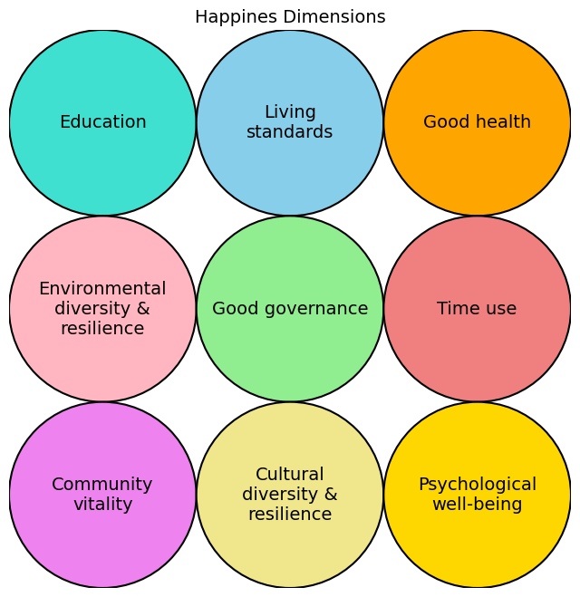
Application to other measures of poverty
Gross National Happiness Index
Alkire (2013)

Slide 27
Application to other multidimensional measures
Women’s Empowerment in Agriculture Index
Domain | Indicators | Weight
Production (1/5) | Input in productive decisions, Autonomy | 1/10
Resources (1/5) | Asset of assets, Purchase/sale/transfer of assets, Access to credit | 1/15
Income (1/5) | Control over use of income | 1/5
Leadership (1/5) | Group member Speaking in public | 1/10
Time (1/5) | Workload, Leisure | 1/10
Alkire et al. (2013)

Slide 28
Application to other multidimensional measures
Financial Inclusion
Dimensions (Weight) | Indicators
Bank account (1/4) | Bank account/ Mobile Money
Loan/Credit (1/4) | Access to loan
Insurance (1/4) | Medical/life/family/income insurance
Financial remittance (1/4) | Remittance from banks, money transfer etc
Koomson et al. (2024)

Slide 29
Application to other multidimensional measures
Energy Poverty
Domain | Indicators
Cooking (0.41) | Modern cooking fuel, Indoor pollution
Lighting (0.20) | Electricity access
Household appliance services (0.13) | Appliance ownership (fridge)
Entertainment/education appliance ownership (0.13) | Entertainment appliances (radio/television/computer)
Communication appliances(0.13) | Ownership of phone (mobile/landline)
Nussbaumer et al. (2012)

Slide 30
Application to other multidimensional measures
Precarious Employment
Domain | Indicators
Employment insecurity/instability (1/4) | No written contract, underemployment, wish to change job
Income inadequacy/instability (1/4) | Minimum wage, irregular wages or salary, Bonuses and commission
Lack of rights and protection (1/4) | Holiday/leave, social security, Health insurance
Unsafe or unhealthy work environment (1/4) | Exposure to dust/fumes, loud noise/vibration, heights at work, chemicals
Opuku et al. (2024)

Slide 31
Application to other multidimensional measures
Women empowerment- General
Domain | Indicators
Autonomy (1/4) | Decision making (earnings, healthcare, large purchases, visits, husbands earning)
Education and Literacy (1/4) | Read part of a sentence (literacy), completed primary education (education)
Access to and control over resources (1/4) | Owns a house, owns a land
Gender Based Violence (1/4) | Justification of wife beating (going out/neglecting children/argues/refuse husband sex/burns food)

Slide 32
Application to other multidimensional measures
Some applications relating to empirical works
1. Koomson, I., Kofinti, R. E., & Laryea, E. (2024). Financial inclusion and multidimensional child poverty. Review of Economics of the Household, 22(1), 237-260.
2. Opoku, A., Nunoo, J., & Kofinti, R. E. (2024). Working but hungry: precarious employment and household food insecurity in Ghana. International Review of Economics, 1-42.
3. Koomson, I., & Danquah, M. (2021). Financial inclusion and energy poverty: Empirical evidence from Ghana. Energy economics, 94, 105085.

Slide 33

Time for hands-on

Slide 34
Time for hands-on
COMPUTING MULTIDIMENSIONAL CHILD POVERTY FROM 2022 KENYA DEMOGRAPHY AND HEALTH SURVEY

Slide 35
Time for hands-on
Activity 1: Create a folder in your drive C and name it ComputeMPI
Activity 2:
Use the link: https://github.com/rkohub7/Multidimensional-Concepts.git
to download ‘KDHS22_indicators.dta” , “Analyses Programme File.do” and “Task at Hand.docx” from “Kenya Child Poverty” folder
Activity 3: Put the downloaded files in the ComputeMPI folder

Slide 36
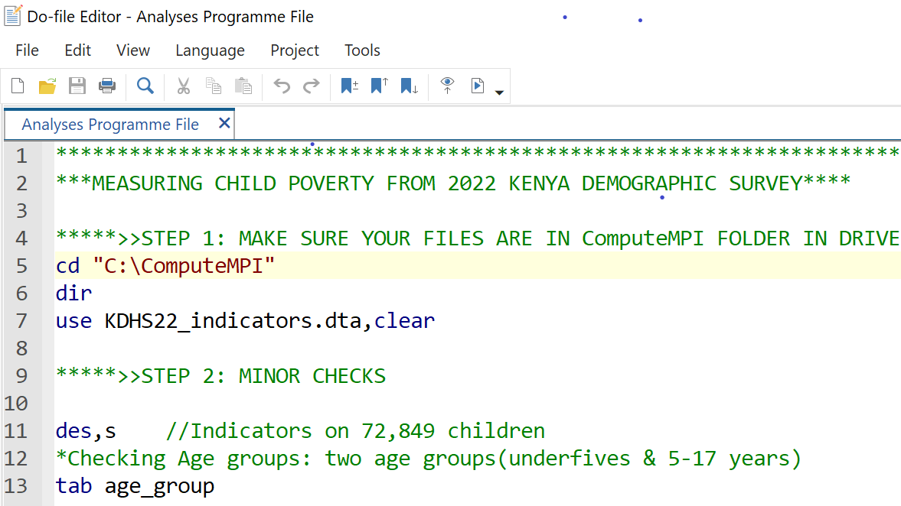
Programme File- STEP 1 & 2

Slide 37
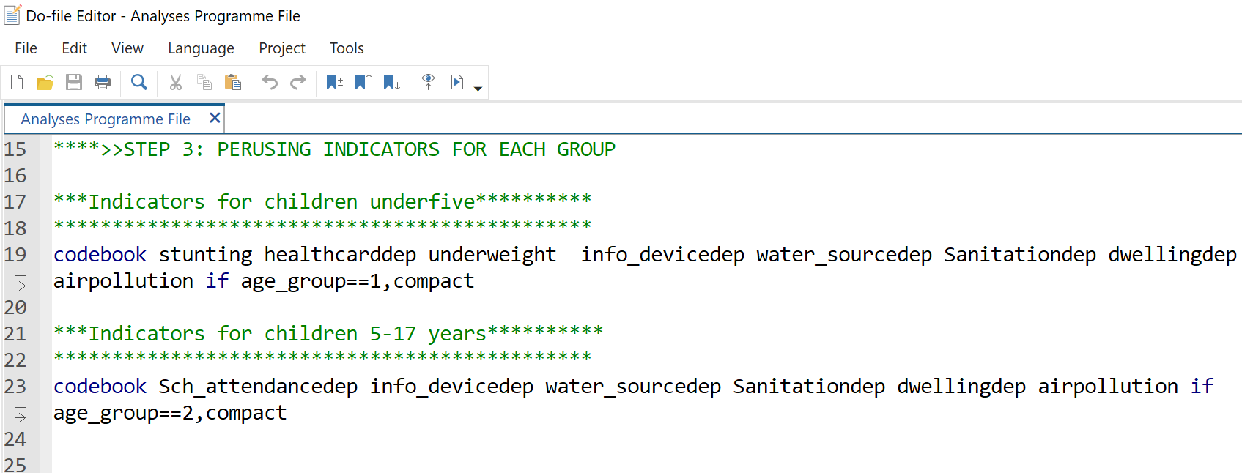
Programme File- STEP 3

Slide 38
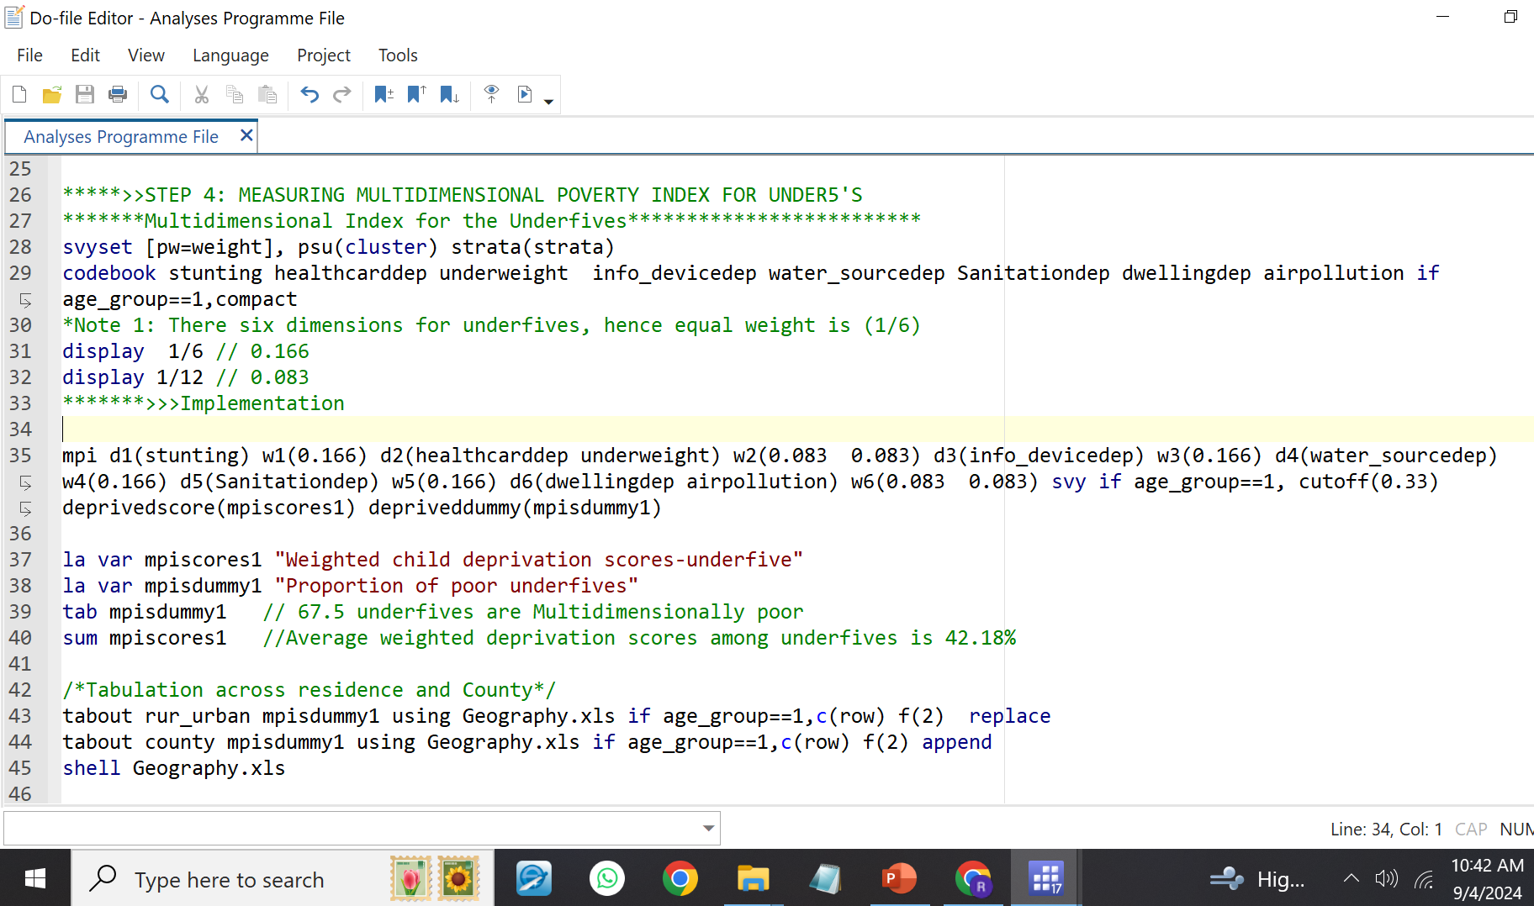
Programme File- STEP 4

Slide 39
KEY RESULTS –FOR CHILDREN UNDERFIVES
Table 1: Key statistics of MPI
 | Coeff. | Std. err. | [95% conf. interval]
Headcount (H) | 0.675 | 0.004 | 0.668 | 0.682
Adjusted Headcount (M0) | 0.372 | 0.002 | 0.367 | 0.376
Intensity (A) | 0.55 | 0.002 | 0.547 | 0.553
Observations |  |  | N=17080
Computed from KDHS, 2022

Slide 40
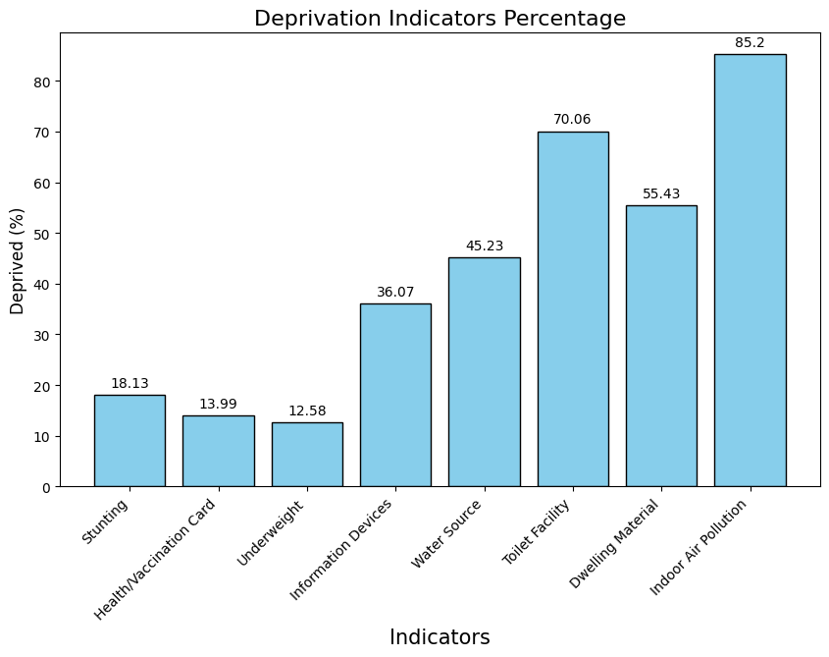
KEY RESULTS –FOR CHILDREN UNDERFIVES

Slide 41
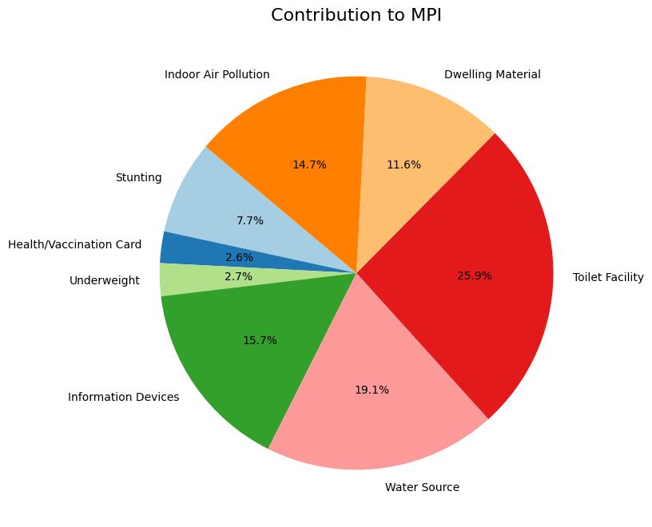
KEY RESULTS –FOR CHILDREN UNDERFIVES

Slide 42
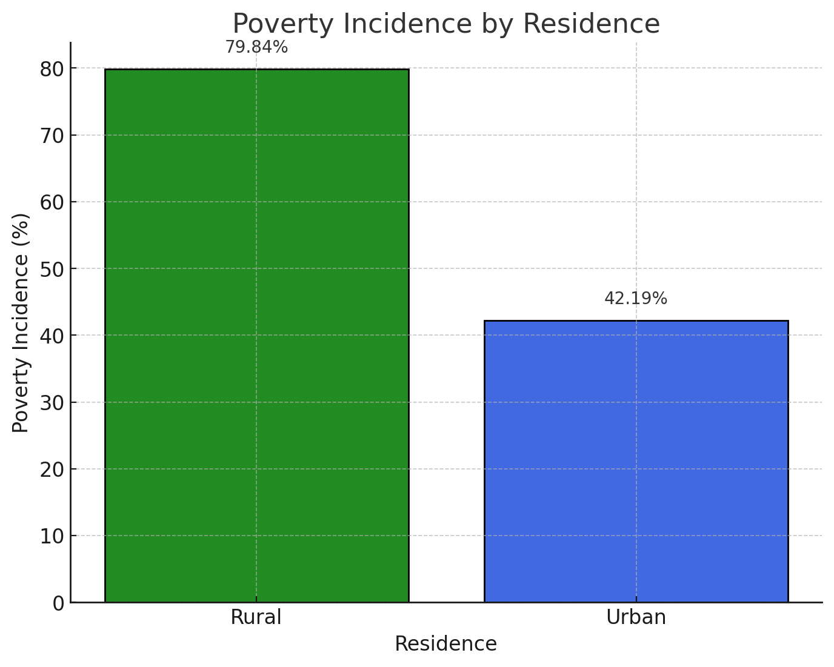
KEY RESULTS –FOR CHILDREN UNDERFIVES

Slide 43
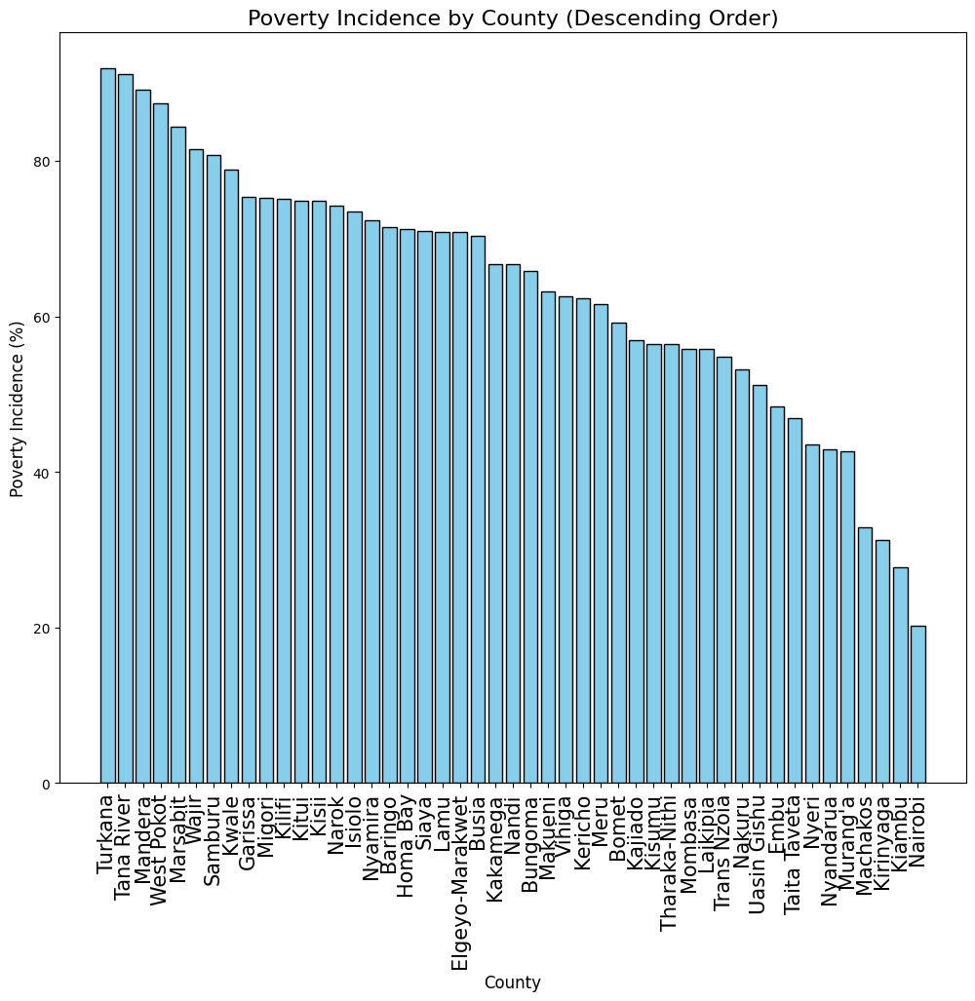
KEY RESULTS –FOR CHILDREN UNDERFIVES

Slide 44





www.aceir.uct.ac.za
YYY ZZZZ
@ARUA_ACEIR
@AfricanCentreofExcellenceforInequalityResearch
ACEIR

